Slide 1

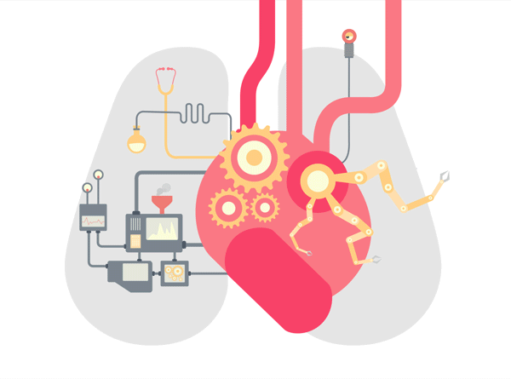
EARLY PRIDICTION OF
LIFE STYLE DISEASE
Under the Guidance of:
Prof. Sindhu N P
Team Members :
Tajuddin Nadaf
Shrinidhi Potadar
Siddarth Daddi

Slide 2
Agenda
INTRODUCTION
AIM & OBJECTIVES
LITERATURE SURVEY
EXISTING SYSTEM
PROPOSED SYSTEM
SYSTEM DESIGN
SYSTEM REQUIREMENT SPECIFICATION
CONCLUSION
FUTURE SCOPE
REFERENCES

Slide 3
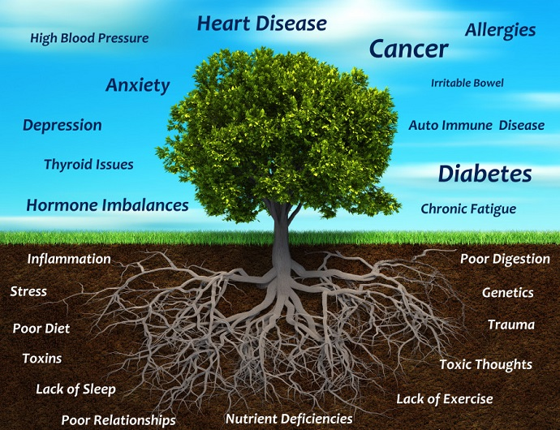
INTRODUCTION
A balanced, healthy dietary pattern includes a variety of fruits, vegetables, whole grains, lean protein, and low-fat dairy products and limits added sugars, saturated fats, and sodium.
Behavioral risk factors such as excessive use of alcohol, bad food habits, eating and smoking tobacco, physical inactivity, wrong body posture and disturbed biological clock increase the likelihood of diseases.

Slide 4
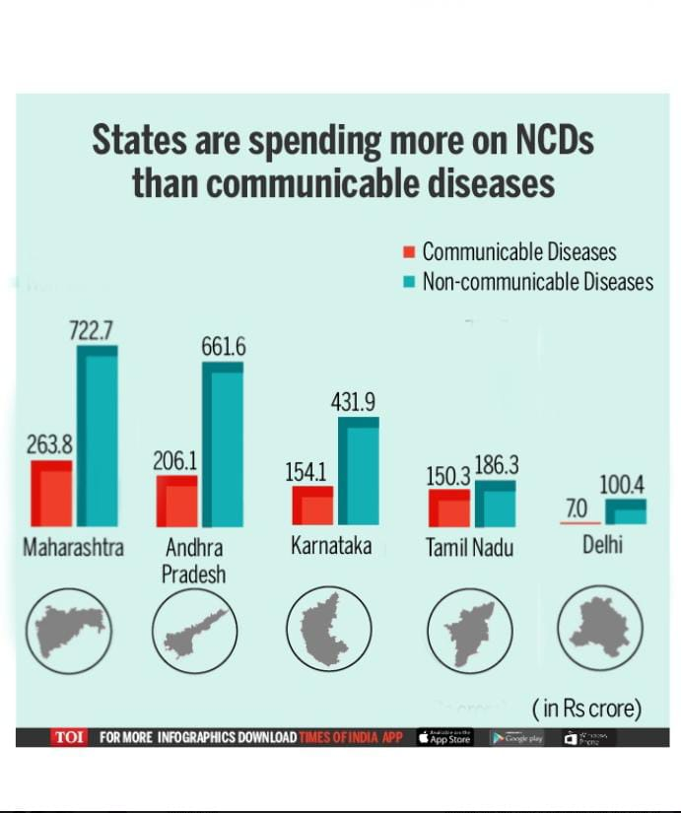
INTRODUCTION
Life style diseases kill around 40 million people each year, that is around 70% of all deaths globally.
In this project we are mainly concentrating on the early detection of lifestyle disease prediction and counter measures.
We are using machine learning algorithms for the prediction of diseases based on the medical dataset.
Making the exploratory data analysis on the features and making the predictions

Slide 5
LITERATURE SURVEY
SI No | Title | Authors | Year | Description
1 | Leveraging and Prediction of Disease Using Machine Learning Techniques | Dr.K. Venkata Ramana | October 2019 | In this paper, they propose a novel healthcare framework to manage lifestyle diseases using long-term activity monitoring. The framework recognizes the user's activities with the help of the sensed data in runtime and reports the irregular and unhealthy activity patterns to a doctor and a caregiver.
2 | Disease Prediction using Machine Learning | Palle Pramod Reddy, Dirisinala Madhu Babu, Hardeep Kumar and Dr.Shivi Sharma | 2021 | The method examines the user's symptoms as input and returns the disease's likelihood as an output. Disease prediction is accomplished using the random forest classifier.
3 | Lifestyle Disease Prediction, Sep. 2022 | Dr.D.J.Samatha Naidu , K.Mahesh | Sep. 2022 | To develop machine learning algorithms in to detect possible genetic disorders caused by unhealthy lifestyles. The proposed work represents recent method that improved algorithms performance and accuracy in distributed environment. In this project we have done analysis using SVM, NB (Naive Bayesian) algorithms by applying validation measures

Slide 6
AIM & OBJECTIVES
AIM
The project is designed to predict medical conditions(Kidney Disease, Liver Disease, Heart Disease) based on user – intputted health parameters.
OBJECTIVES
As per the above mentioned aim , herewith we have planned our project as:
Data Collection from the standard medical dataset
Data preprocessing and Analysis
Machine learning Model development using supervised learning algorithms ( Random Forest, Support Vector Machines , Decision Tree, K-Nearest Neighbor and other algorithms ).
Prediction of Chronic Kidney Disease, Liver disease and Cardiovascular Disease.
Development of Web based Application to demonstrate the disease prediction and measures to cure.

Slide 7
PROPOSED SYSTEM
This main objective of the project is to predict Lifestyle Diseases based on full features of dataset using Machine Learning Algorithms.
In this perception, Logistic Regression, Support Vector Machine Classifier, Random Forest Classifier, Decision Tree Classifier and Artificial Neural Network are applied.
Performance Evaluation and comparison study of algorithms are calculated and finding the best accuracy and other specific metrics.
Exploratory data Analysis on Dataset.
Finally we are developing An web based application to input the medical record and check the type of disease .

Slide 8
ADVANTAGES
Advantages of the Proposed System:
We are creating one of the recommendation system , whcih will be useful for any kind of medical record data
1. We have increased the accuracy of the system to 91%
2. Web application is created which is very user friendly and easy to use
3. The full fledged features are used for the prediction
4. Comparison of different algorithms can give for flexibility to use best Model

Slide 9
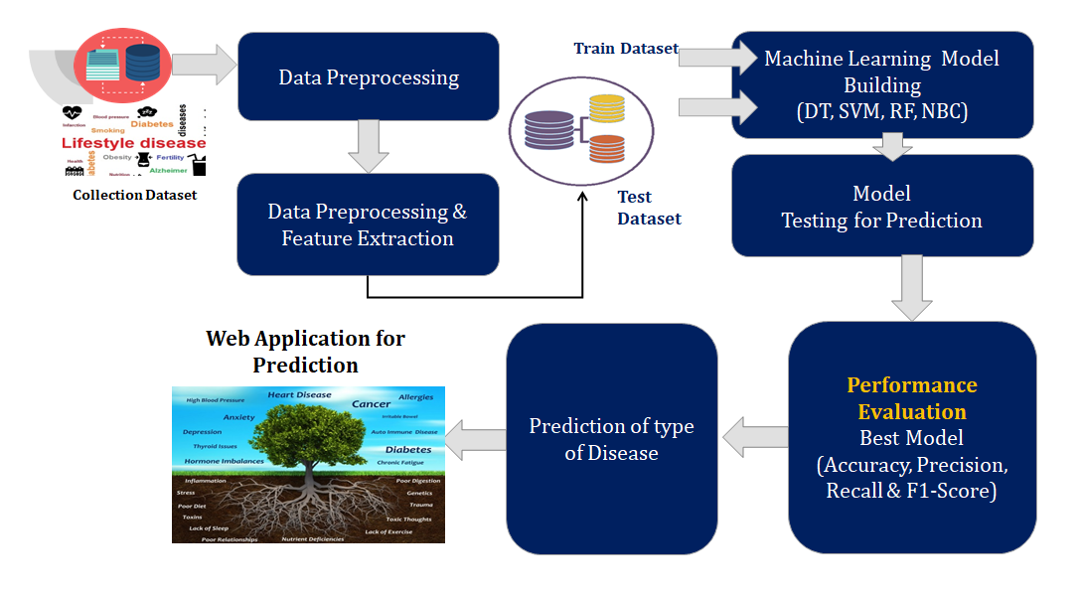

Slide 10
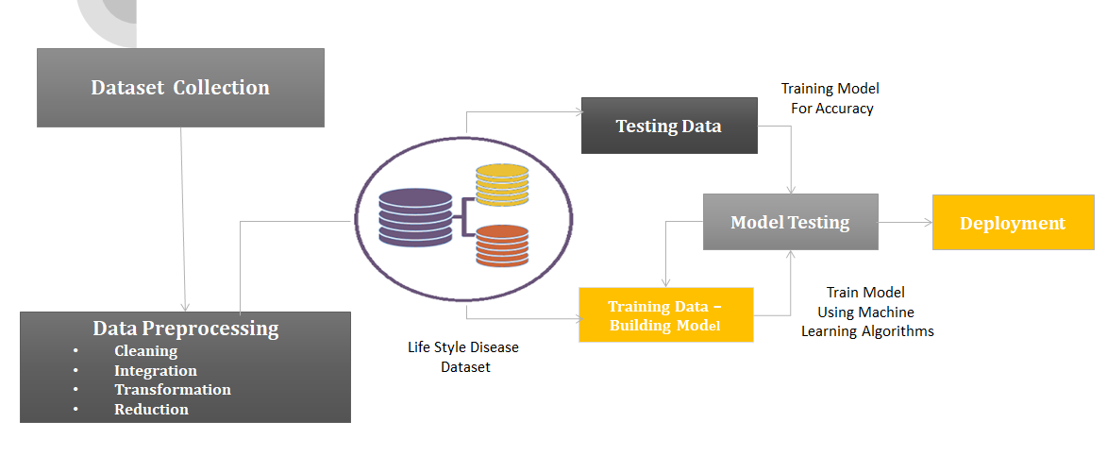
Architecture Diagram

Slide 11
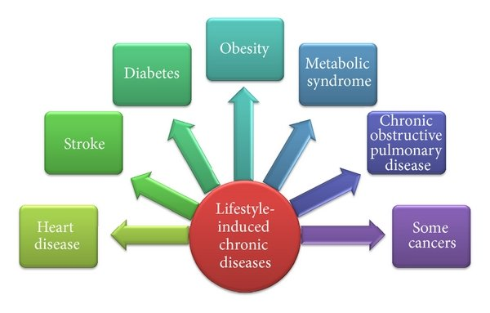
MODULES
Data Collection
Pre-processing & Feature Extractions
Training and Testing the Model
Deploying Machine learning Models ( DT, SVM , RF, NBC)
Prediction of Lifestyle Diseases
Web Interface to Predict the Life Style Disease

Slide 12
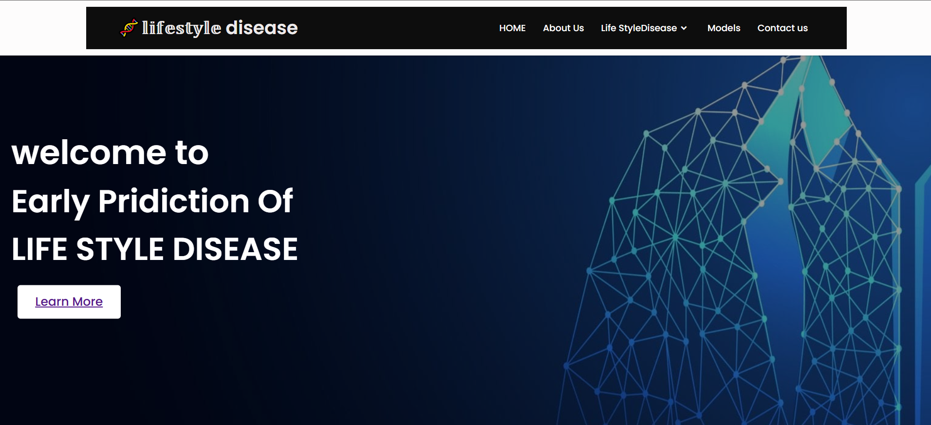
Web Application
Home Page

Slide 13
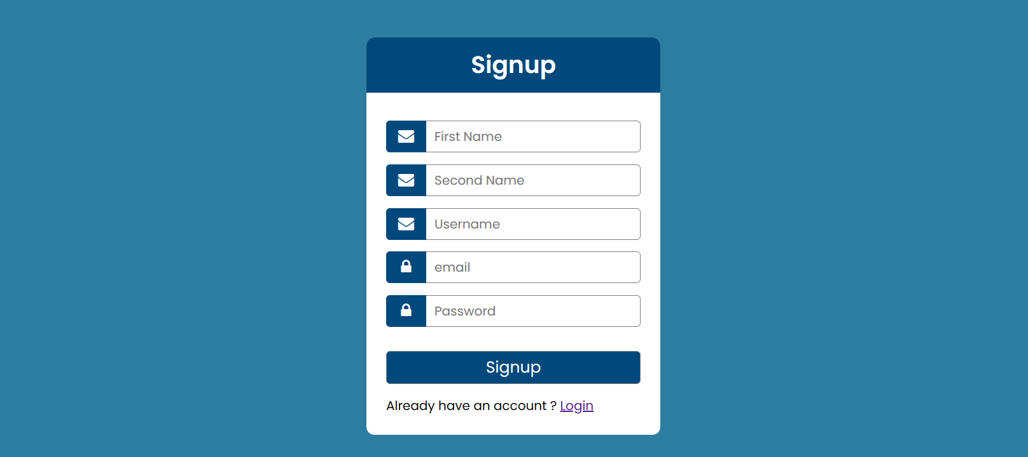
Signup Page

Slide 14
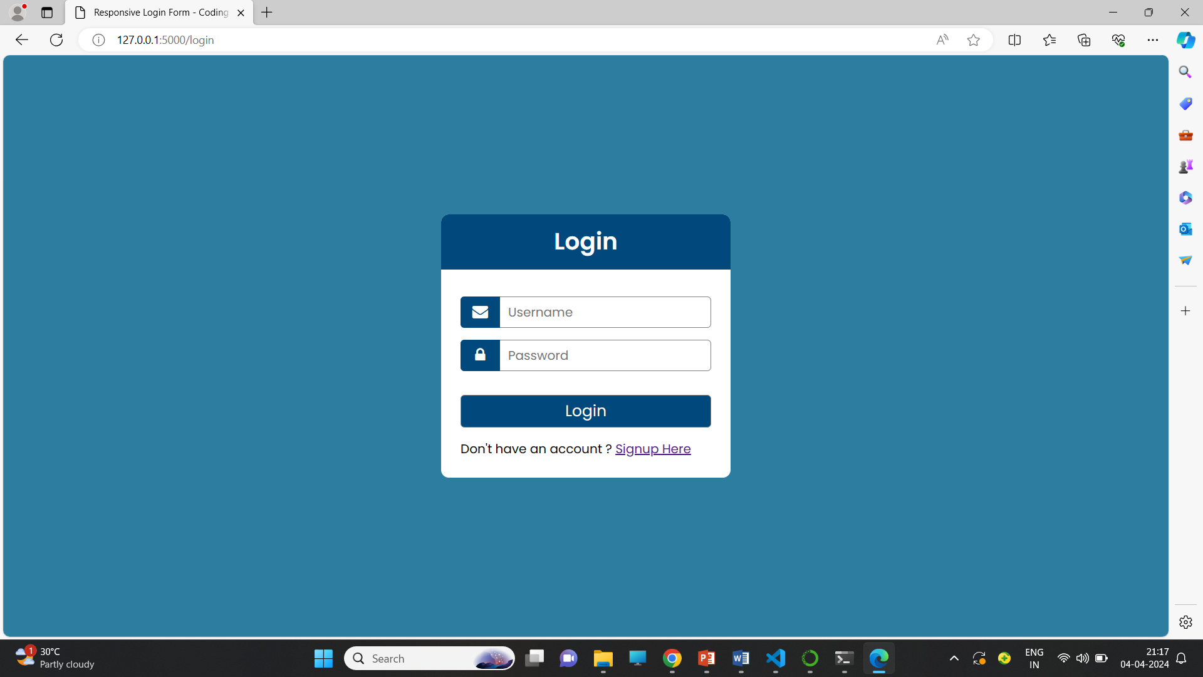
Login Page

Slide 15
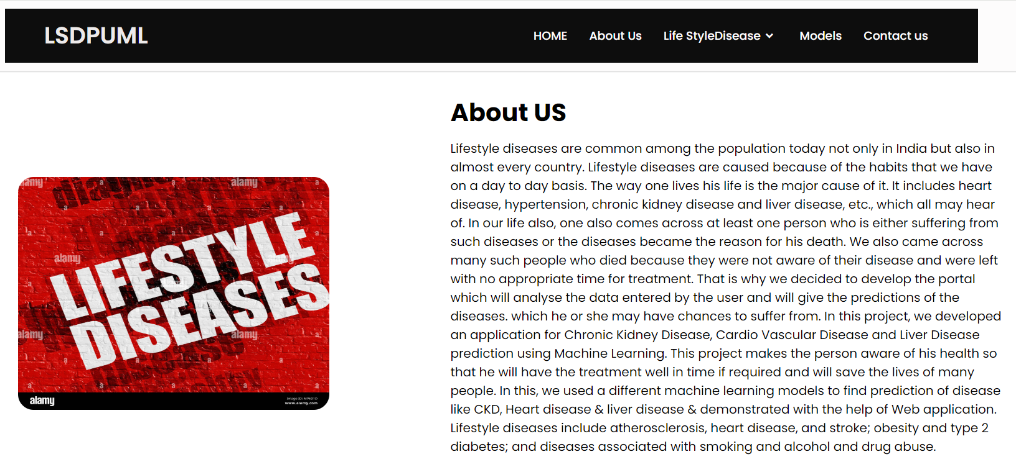
About Us

Slide 16
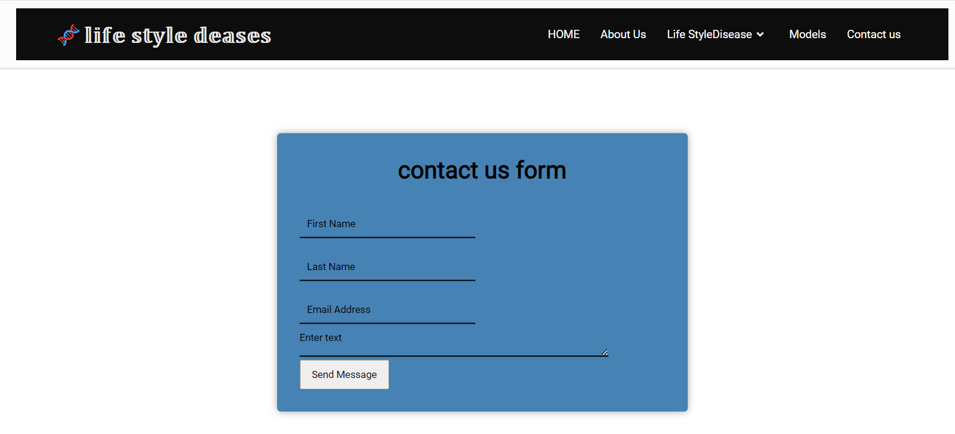
Contact us

Slide 17
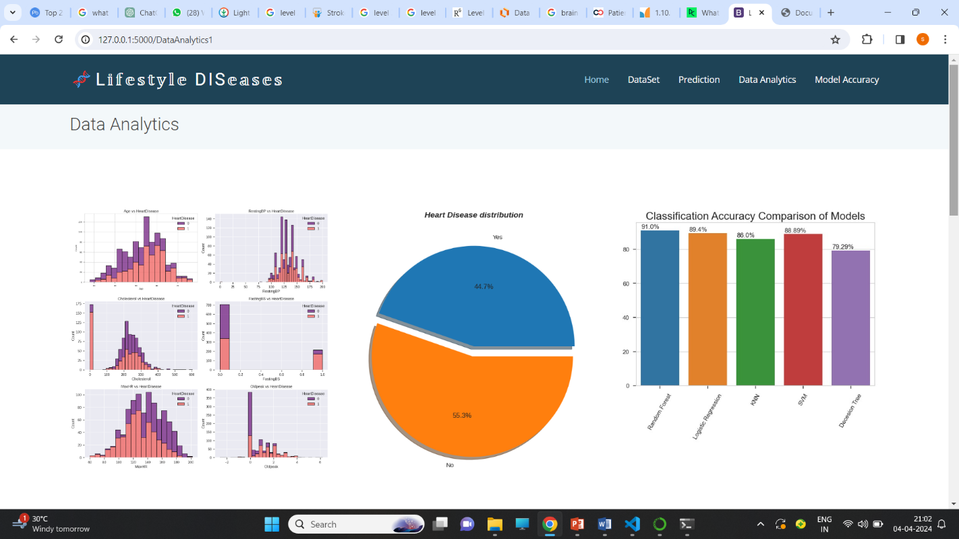
Data Analysis

Slide 18
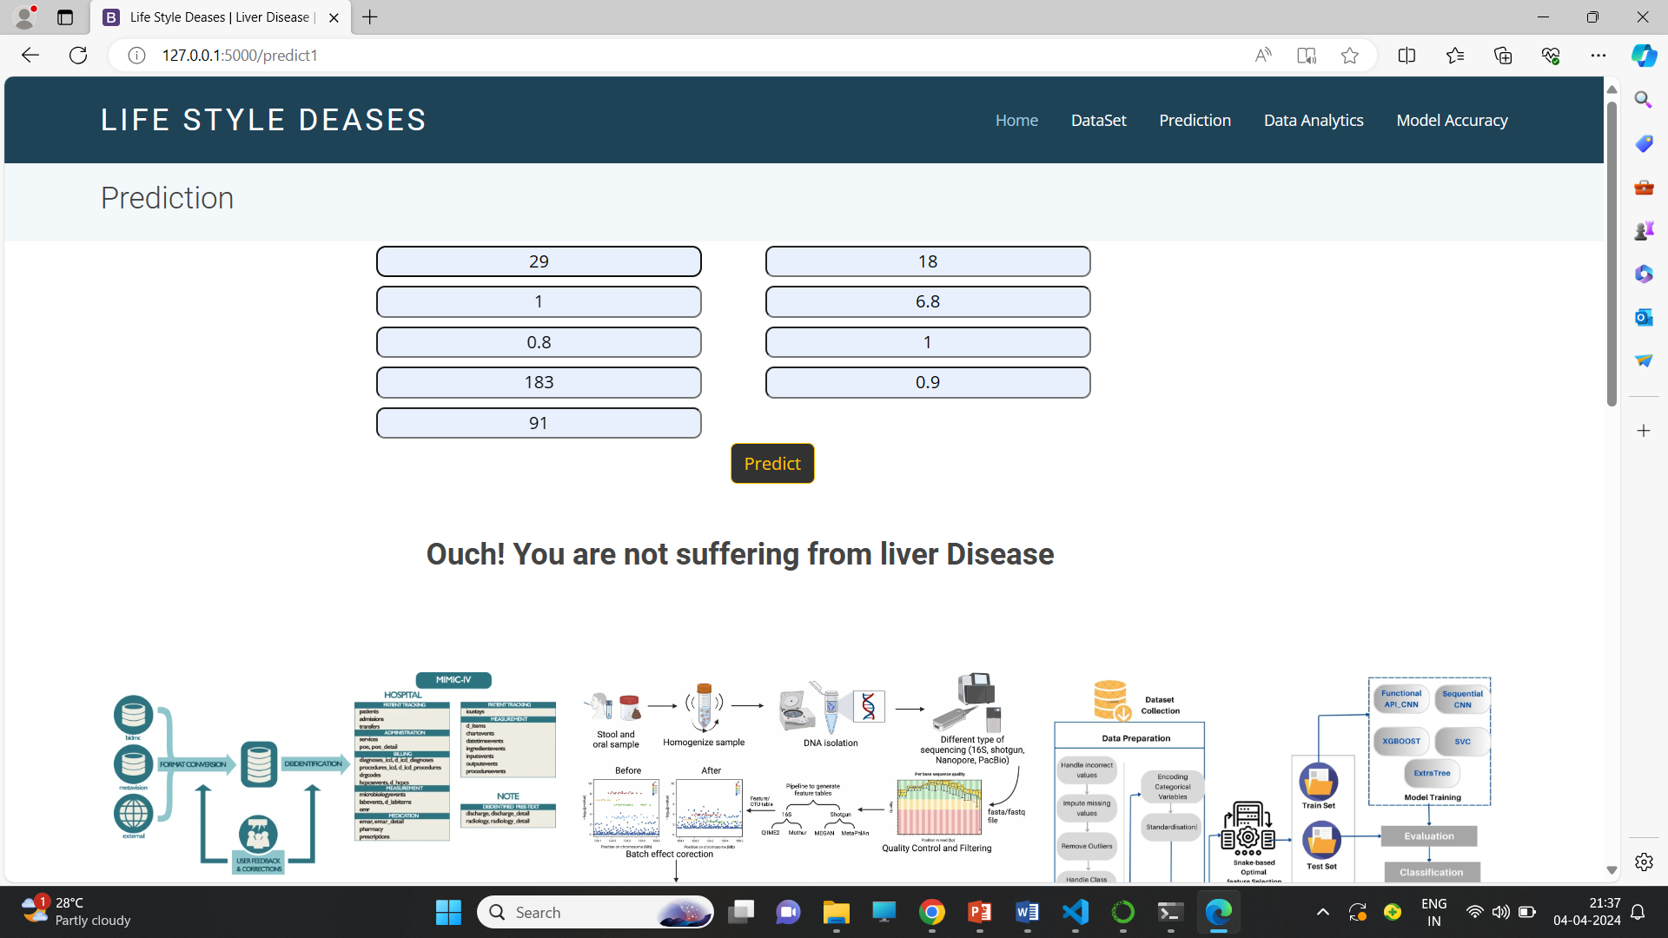
Liver Disease Prediction

Slide 19
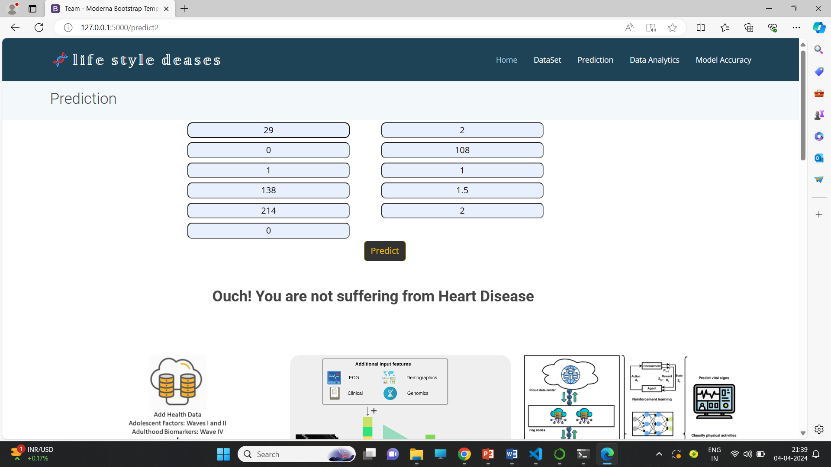
Heart Disease Prediction

Slide 20
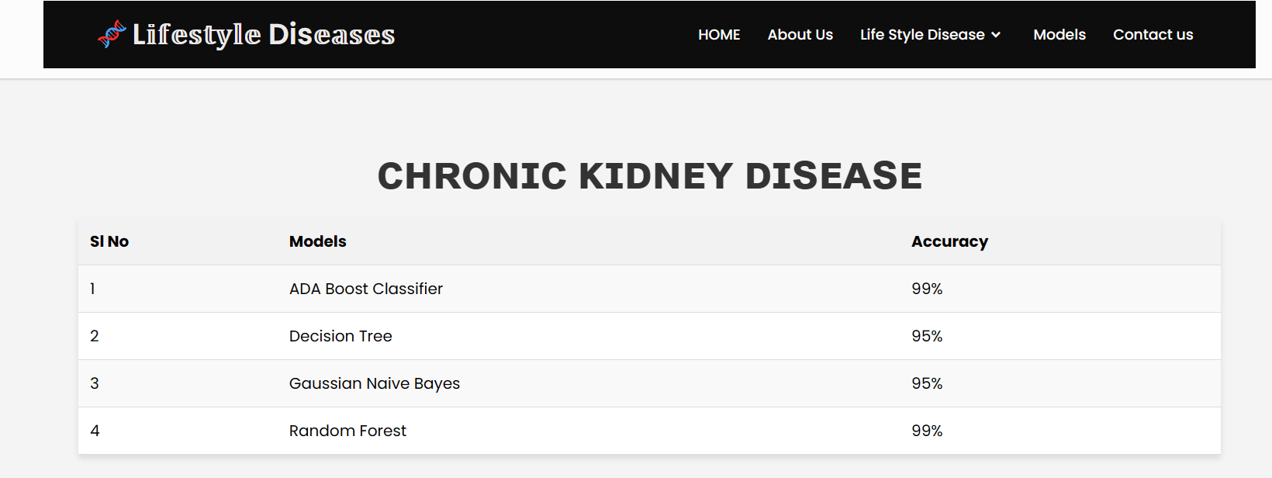
CKD Model Accuracy

Slide 21
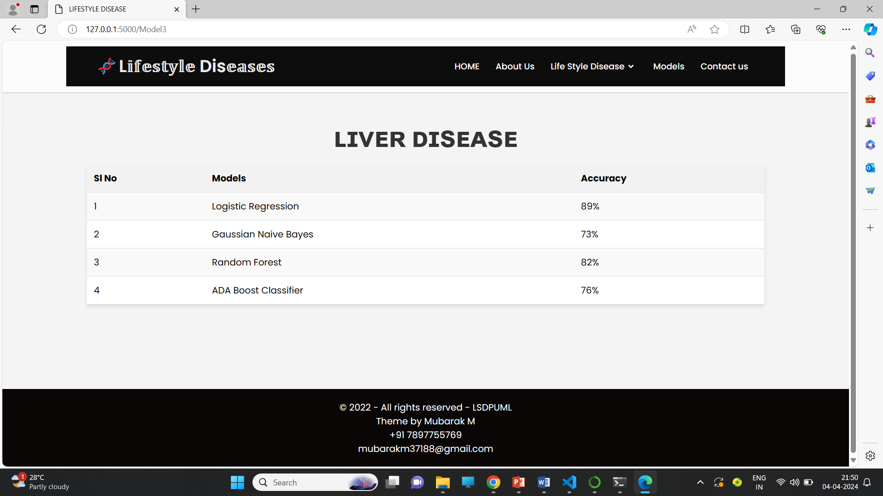
Liver Disease Model Accuracy

Slide 22
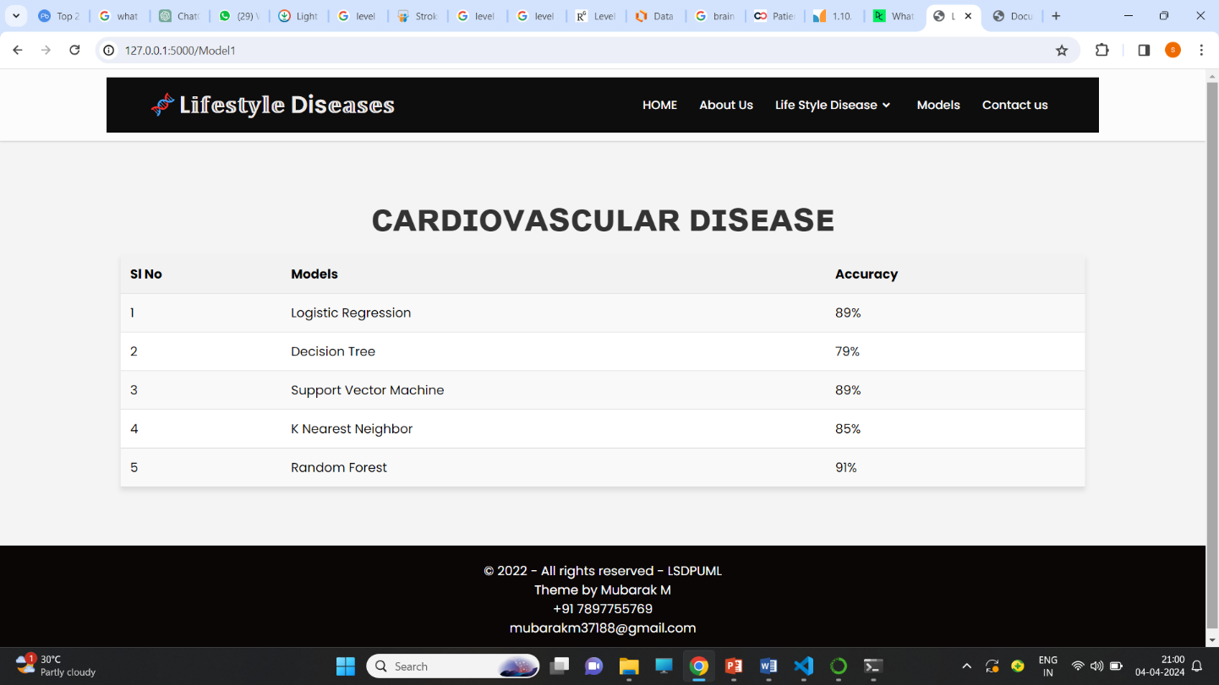
Cardio Vascular Disease Model Accuracy

Slide 23
SYSTEM REQUIREMENT SPECIFICATIONS
Hardware Requirements
Processor : 3.0 GHz and Above
Output Devices : Monitor (LCD)
Input Devices : Keyboard
Hard Disk : 256 GB
RAM : 8GB or Above
Software Requirements
Scripting language : Python Programming
Scripting Tool : Anaconda Navigator (Jupyter Notebook) & Google Colab
Operating System : Microsoft Windows 7, 8 or 10
Dataset : UCI Machine Learning Repository
Machine Learning Packages : Numpy, Pandas, Matplotlib, Seaborn Packages etc.

Slide 24
CONCLUSION
Various machine learning algorithms are applied on CKD, Heart disease & Liver disease prediction. We have made a brief literature survey on numerous articles to get the get of research gap and the area to enhance the work .We have totally used four classification algorithm , among that Random Forest proving the best accuracy of 99% in evaluating and predicting both CKd & No-CKD and liver disease or not analysis. We have used the concept of exploratory data analysis to plot various graphical representations. We developed a web application to demonstrate the Chronic Kidney Disease, Heart Disease and Liver Disease.

Slide 25
FUTURE SCOPE
The future scope for lifestyle disease prediction using machine learning involves forecasting an individual's propensity or risk of developing certain diseases based on their current lifestyle factors and health indicators. This score aims to predict the likelihood of someone developing a particular disease in the future, allowing for preventive measures or interventions to be taken proactively. Here's how this could be approached:
1. Time-based Prediction and Evaluation:
- Time-Series Models: Employ time-series models or methodologies to account for trends or changes in lifestyle and health indicators over time.
Evaluation Metrics: Assess model performance using appropriate metrics for future prediction tasks, considering predictive accuracy, precision, recall, etc., for future time periods.
2. Interpretation and Application:
- Interpretability: Ensure the model's interpretability to understand how different lifestyle factors contribute to the future disease risk score.
- Risk Stratification: Develop risk categories or thresholds based on the future score to stratify individuals into low, medium, and high-risk groups.
Recommendations and Interventions: Provide personalized recommendations or interventions based on the predicted future score to mitigate risks, such as lifestyle modifications, regular screenings, or targeted interventions.

Slide 26
REFERENCES
[1] Linta Antony, Sami Azam, Ryana Quadir “A Comprehensive Unsupervised Framework for Chronic Kidney Disease Prediction”, IEEE ACCESS, PP 126481 – 126501 VOLUME 9 2021
[2] Davide Chicco 1, Christopher A. Lovejoy 2,3, And Luca Oneto, “A Machine Learning Analysis of Health Records of Patients With Chronic Kidney Disease at Risk of Cardiovascular Disease”, IEEE ACCESS, PP 165133 – 165144 VOLUME 9 2021
[3] Jiongming Qin 1, Lin Chen 2, Yuhua Liu 1, Chuanjun Liu 2, “A Machine Learning Methodology for Diagnosing Chronic Kidney Disease”, IEEE ACCESS, PP 20991 – 21002 VOLUME 8 2020
[4] Bilal Khan, Rashid Naseem, Fazal Muhammad, Ghulam Abbas, And Sunghwan Kim 5 “An Empirical Evaluation Of Machine Learning Techniques for Chronic Kidney Disease Prophecy” ”, IEEE ACCESS, PP 55012– 55022165144 VOLUME 8 2020.

Slide 27
THANK YOU!!!

